Slide 1
Project1: Car Price Prediction Project2: HR Analytics
Submitted To-
Ms. Pooja Gupta
Senior Consultant
Henry Harvin Education
Submitted By-
Arunabh Borah
Intern
Henry Harvin Education

Slide 2
Car Price Prediction
In Car Price Prediction we try to predict the price of second-hand cars. There are many factors that influence the price of a car in the second-hand market.
Our goal:
Data understanding and exploration
Data Cleaning and preparation
Data visualization
Model building and evaluation

Slide 3
Data Understanding and Exploration
To understand the data we imported libraries such as
Pandas
Numpy
Matplotlib.pyplot
Seaborn
Statsmodels.api

Slide 4
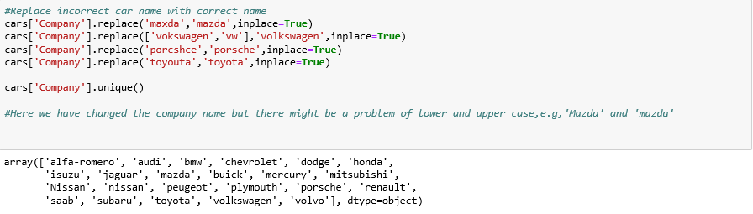

Data Cleaning
We replaced all the incorrect company name with right company name
Maintaining uniformity by converting it into lower case

Slide 5
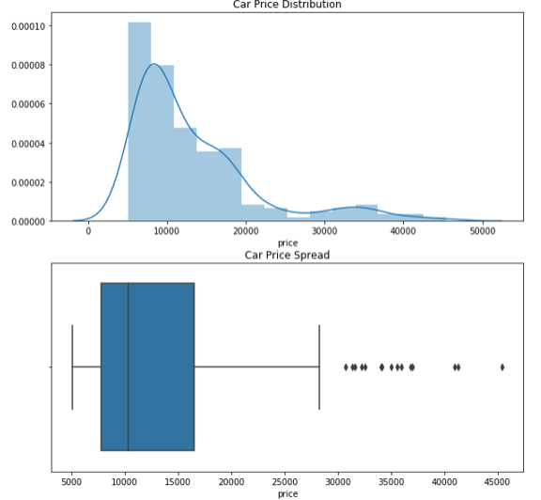
Data Visualization
As part of Exploratory Data Analysis, we visualized various factors predicting the price of used cars

Slide 6
Visualization of categorical data
Company
Symboling
Fuel type
Engine type
Car body
Door number
Engine location
Fuel system
Cylinder number
Aspiration
Drive wheel

Slide 7
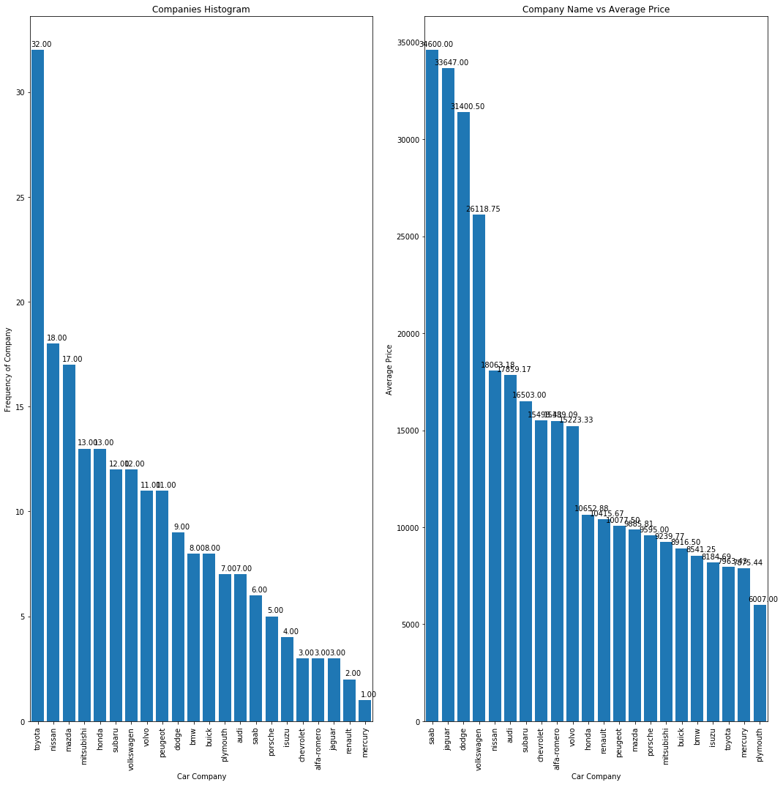
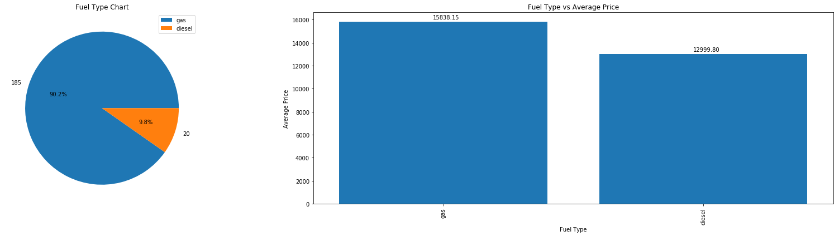
Plotting of car company and average price
Fuel Type and Average price

Slide 8
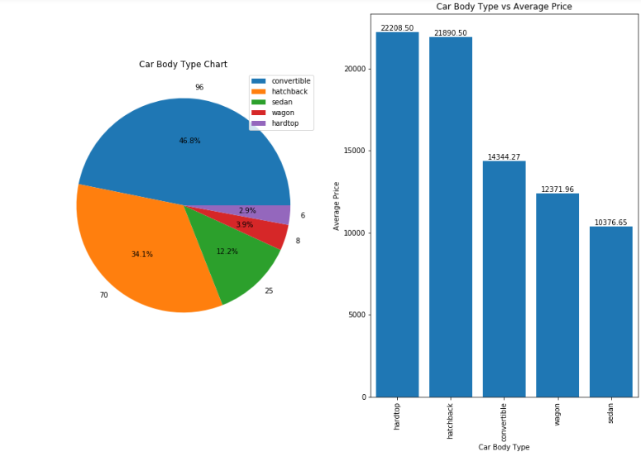
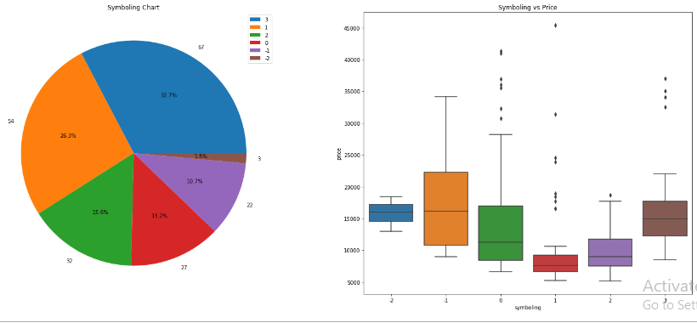
Car Body Type v/s Average Price
Symboling v/s Price

Slide 9
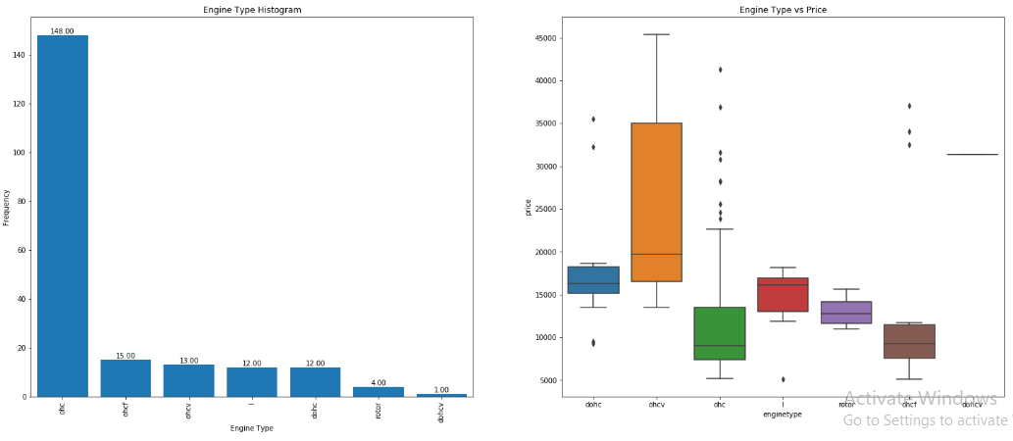
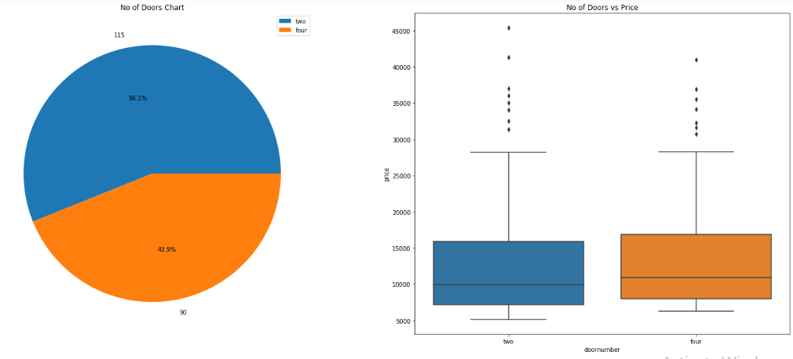
Engine type v/s price
Number of doors v/s Price

Slide 10
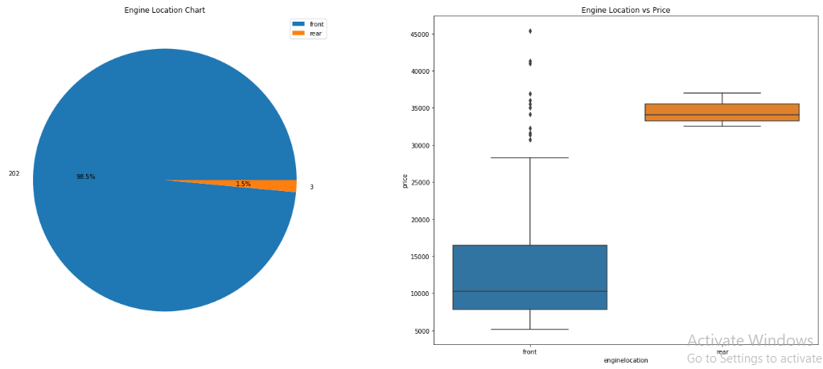
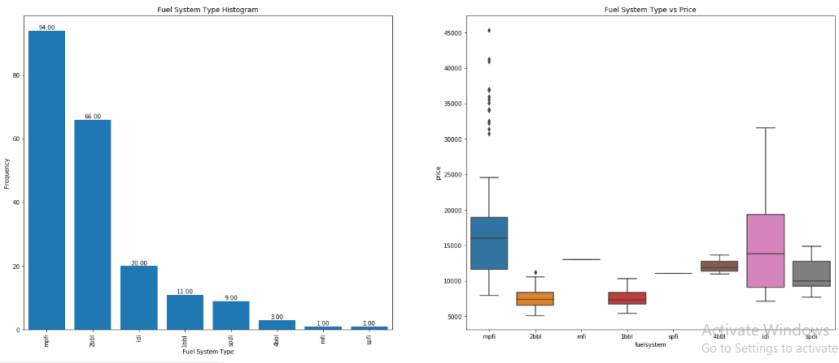
Engine location v/s price
Fuel System type v/s price

Slide 11
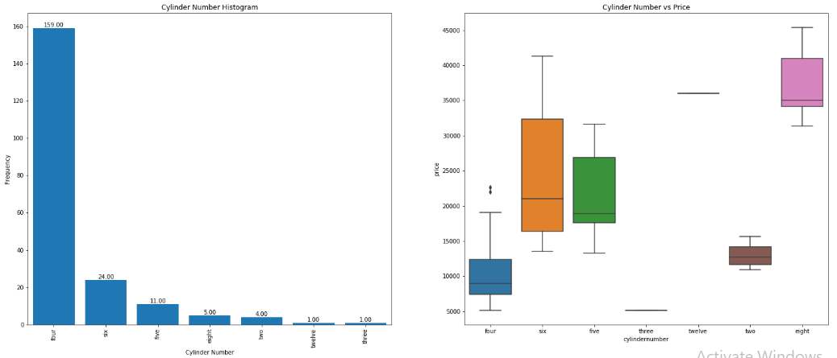
Visualizing Cylinder Number

Slide 12
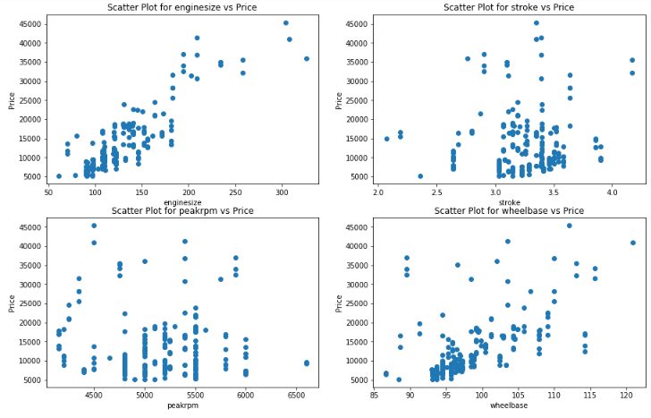
Scatter Plot of Various numerical variable

Slide 13
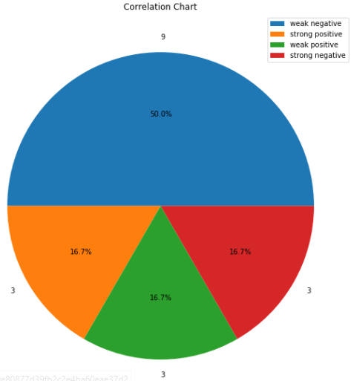
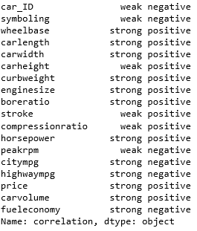

Correlation with target variable(price)
Parameters

Slide 14

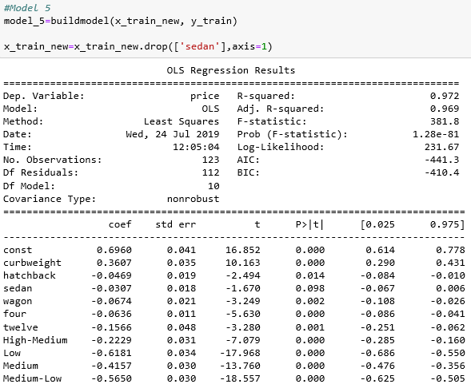
Regression Analysis
Eliminating all the attributes with p>0.05

Slide 15

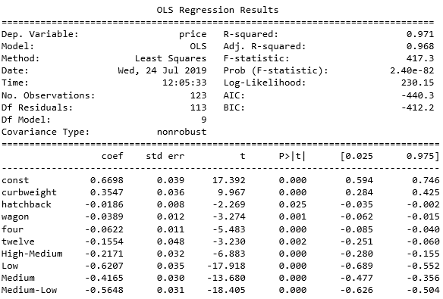
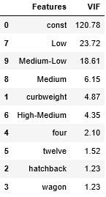
Building VIF Function
Function to remove all the relationship

Slide 16

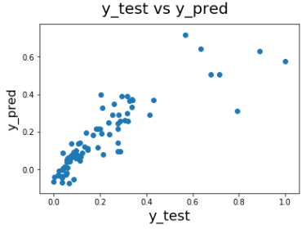
Accuracy score of prediction

Slide 17
HR Analytics
Project HR Analytics is focused on employee attrition rate of a company depending upon various factors such as
Satisfaction_level
Work_accident
Promotion_last_5years
Department
Salary
Goals
Correlation between various factors
Visualization of data
Regression Analysis of attrition rate

Slide 18

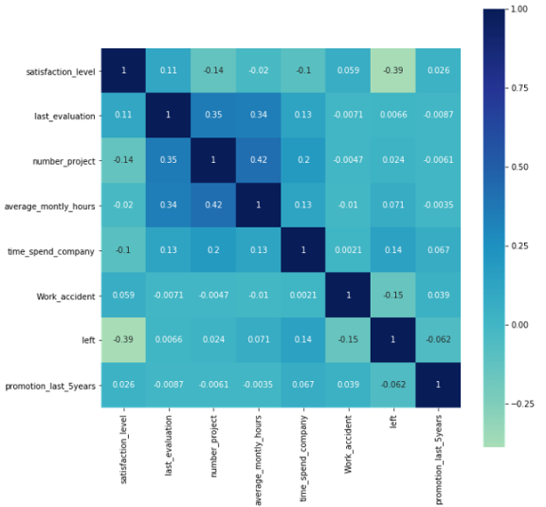
Analysis
Importing libraries and ‘HR_Processed_data.xlsx’ dataset
Correlation heatmap

Slide 19
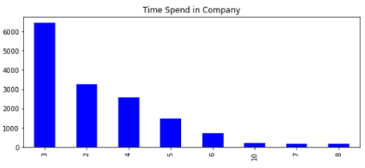
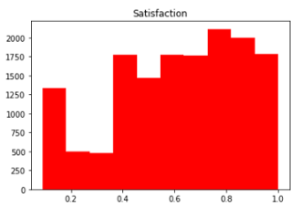
Visualization
Time spent in company
Satisfaction level of employee

Slide 20
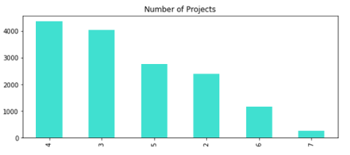
Number of projects by employee

Slide 21


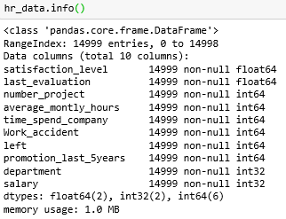
Regression Analysis
Changing categorical variable into numerical

Slide 22

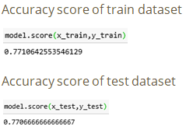
Splitting data into train and test

Slide 23
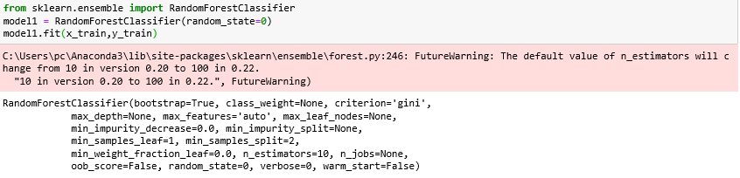
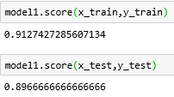
Now, to increase the accuracy we apply Random Forest
Accuracy of train and test

Slide 24
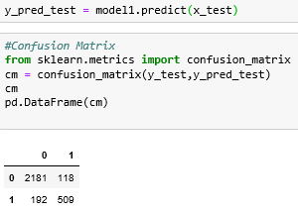
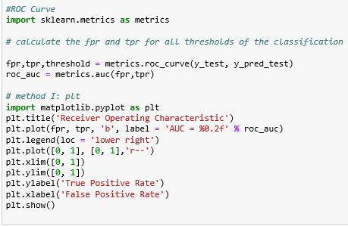
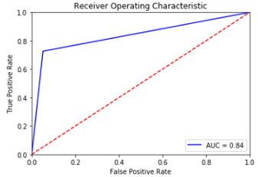
Confusion matrix and ROC Curve

Slide 25
THANK YOU

